Slide 1
Linear Algebra
线性代数
Zongbin Chen YMSC, Tsinghua University
陈宗彬 清华大学数学科学中心
Email: zbchen@tsinghua.edu.can

Slide 2


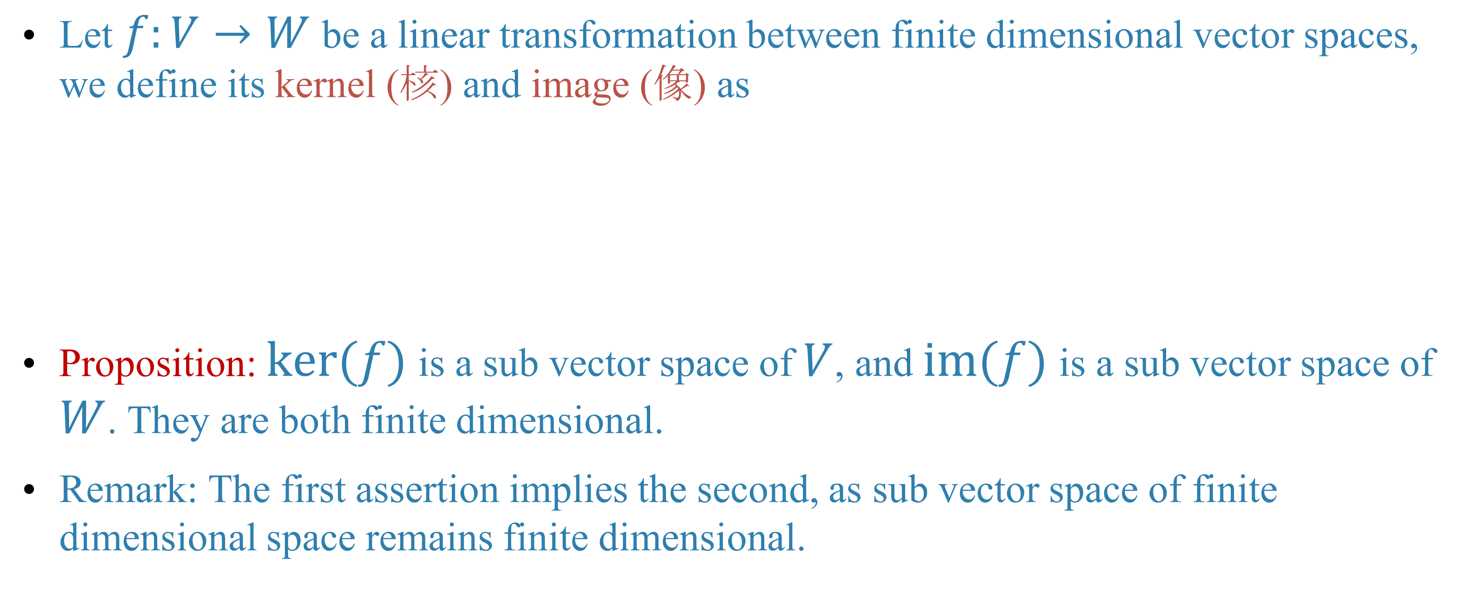

Quick review
The kernel and image of a linear transformation
Let $f:V→W$ be a linear transformation between finite dimensional vector spaces, we define its kernel (核) and image (像) as
Proposition: $ker(f)$ is a sub vector space of $V$, and $im(f)$ is a sub vector space of $W$. They are both finite dimensional.
Remark: The first assertion implies the second, as sub vector space of finite dimensional space remains finite dimensional.

Slide 3
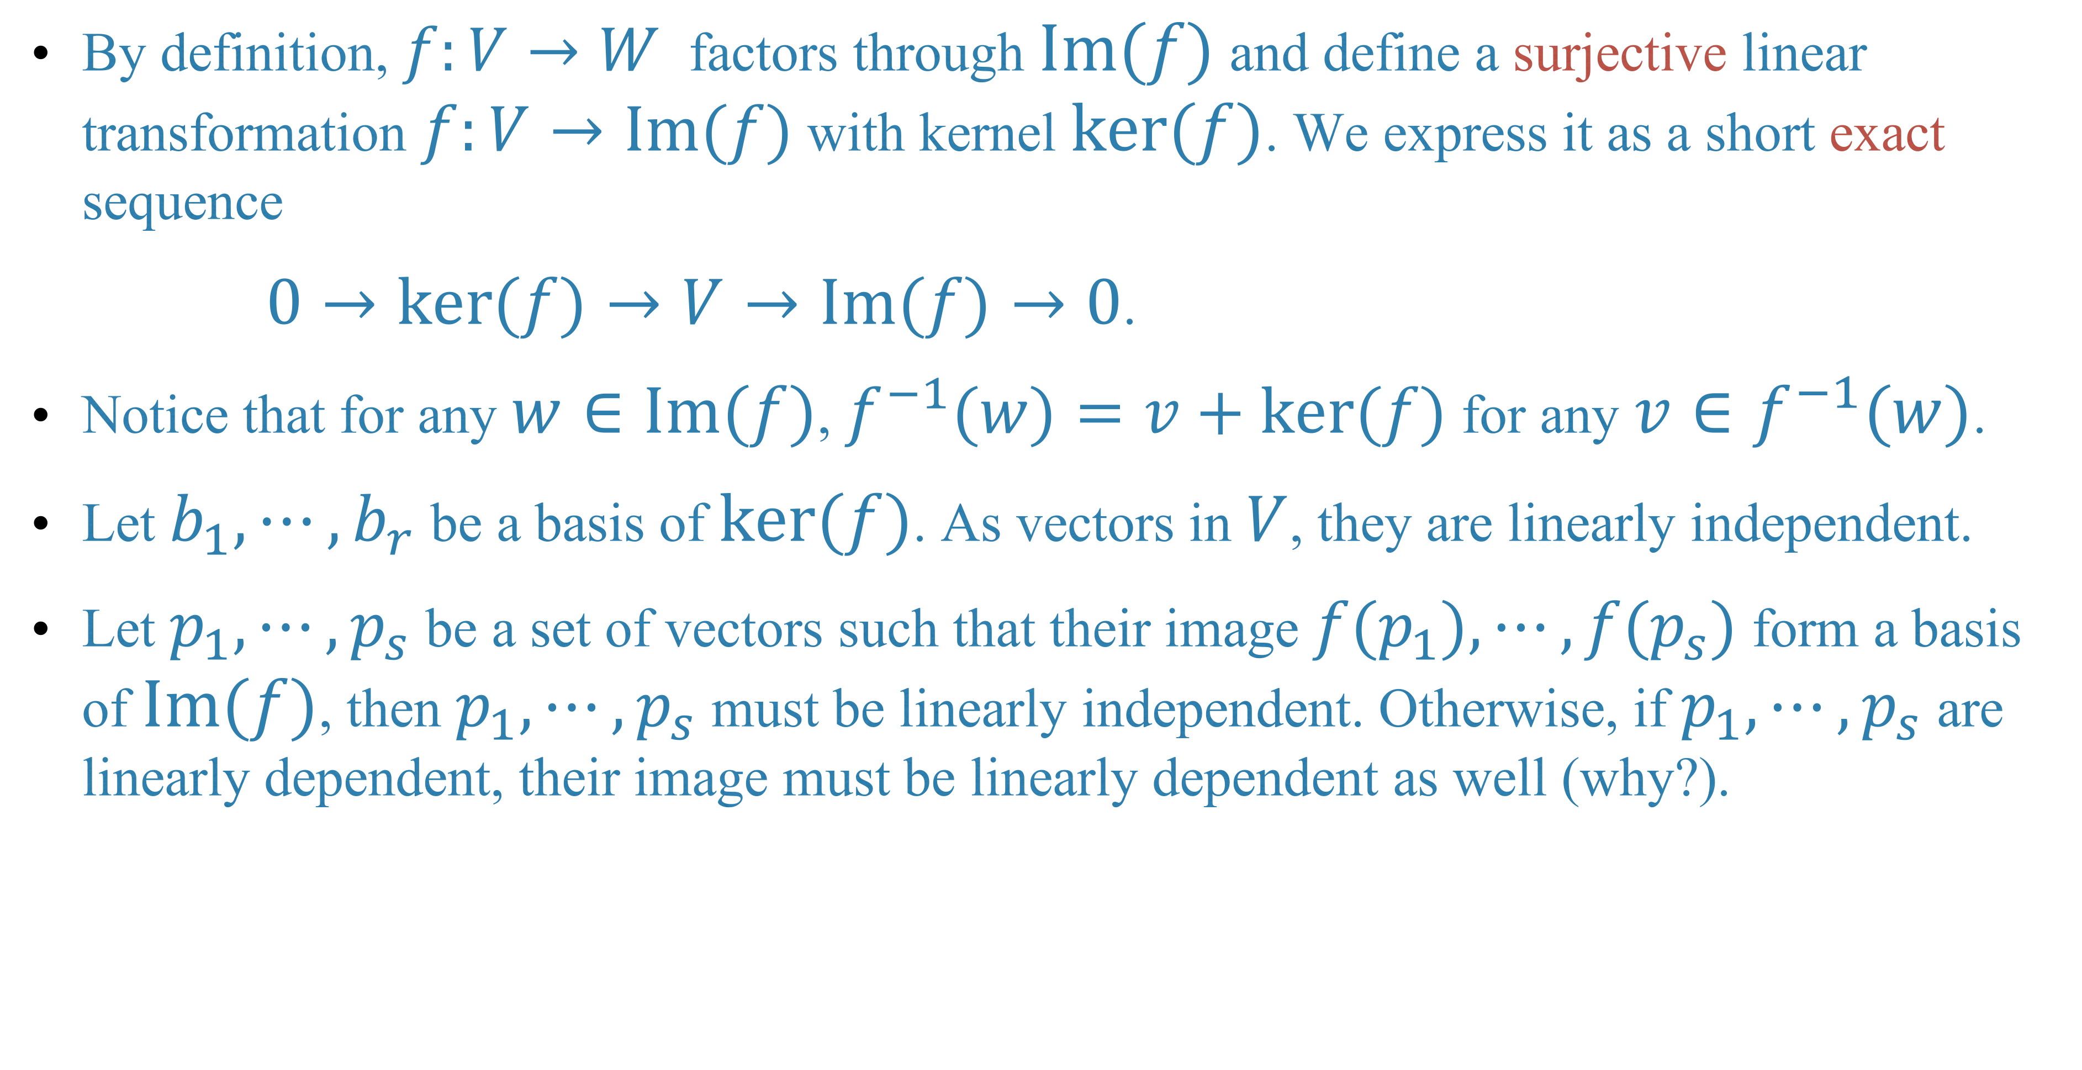
By definition, $f:V→W$ factors through $Im(f)$ and define a surjective linear transformation $f:V→Im(f)$ with kernel $ker(f)$. We express it as a short exact sequence
$0→ker(f)→V→Im(f)→0$.
Notice that for any $w∈Im(f)$, $f^{−1}(w)=v+ker(f)$ for any $v∈f^{−1}(w)$.
Let $b_{1},⋯,b_{r}$ be a basis of $ker(f)$. As vectors in $V$, they are linearly independent.
Let $p_{1},⋯,p_{s}$ be a set of vectors such that their image $f(p_{1}),⋯,f(p_{s})$ form a basis of $Im(f)$, then $p_{1},⋯,p_{s}$ must be linearly independent. Otherwise, if $p_{1},⋯,p_{s}$ are linearly dependent, their image must be linearly dependent as well (why?).

Slide 4
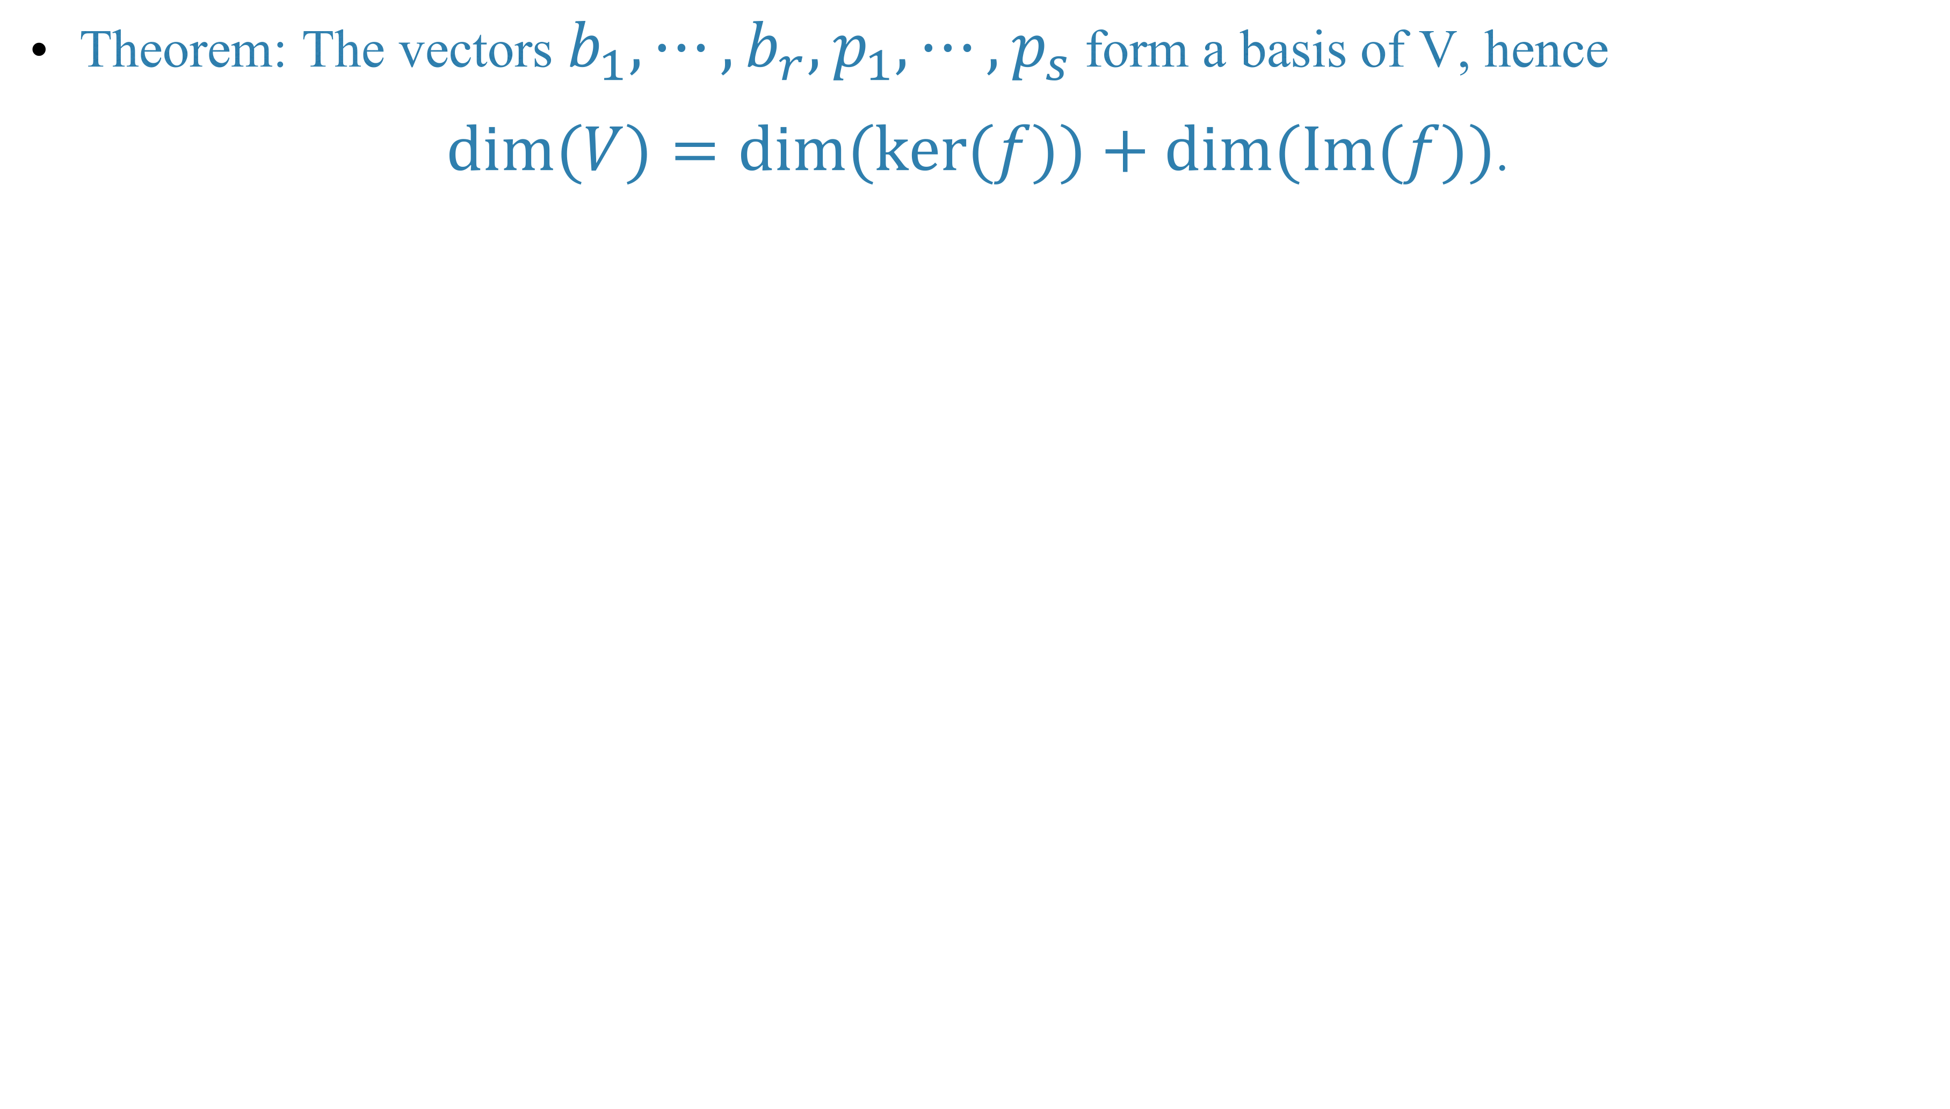
Theorem: The vectors $b_{1},⋯,b_{r},p_{1},⋯,p_{s}$ form a basis of V, hence
$dim(V)=dim(ker(f))+dim(Im(f))$.

Slide 7
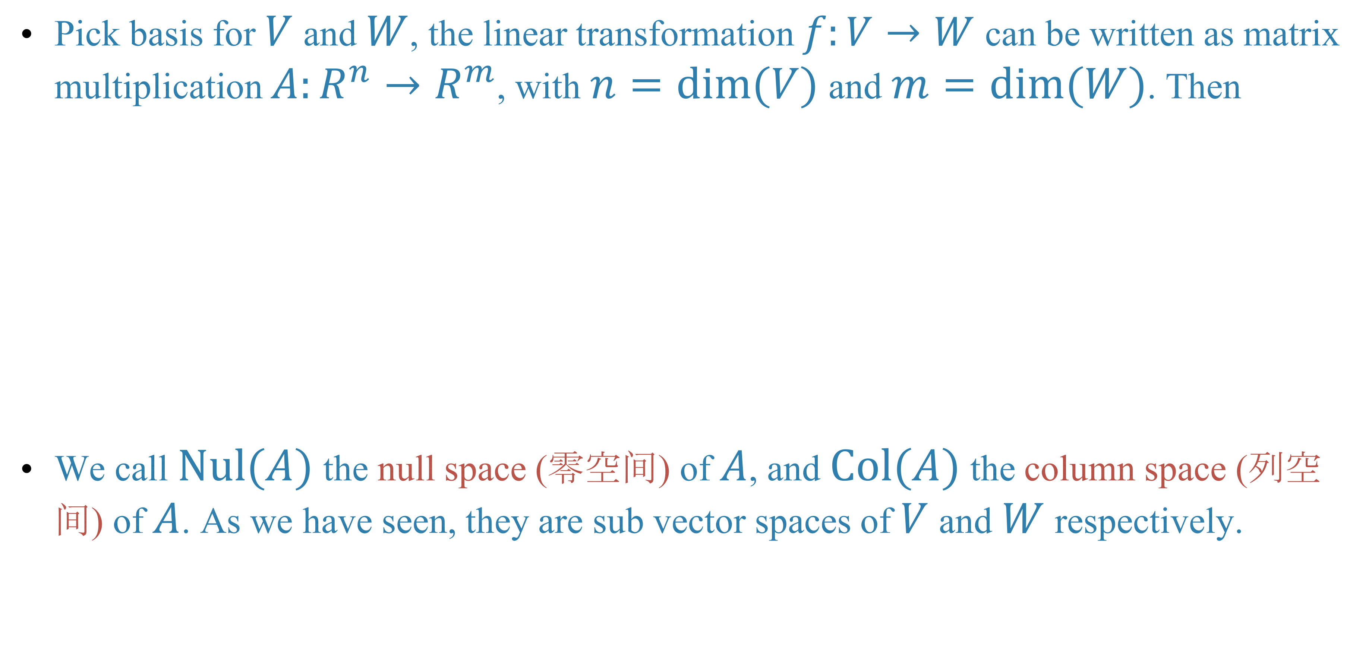

Column space and null space of a matrix
Pick basis for $V$ and $W$, the linear transformation $f:V→W$ can be written as matrix multiplication $A:R^{n}→R^{m}$, with $n=dim(V)$ and $m=dim(W)$. Then
We call $Nul(A)$ the null space (零空间) of $A$, and $Col(A)$ the column space (列空间) of $A$. As we have seen, they are sub vector spaces of $V$ and $W$ respectively.

Slide 8
Theorem

Slide 9
Theorem

Slide 11
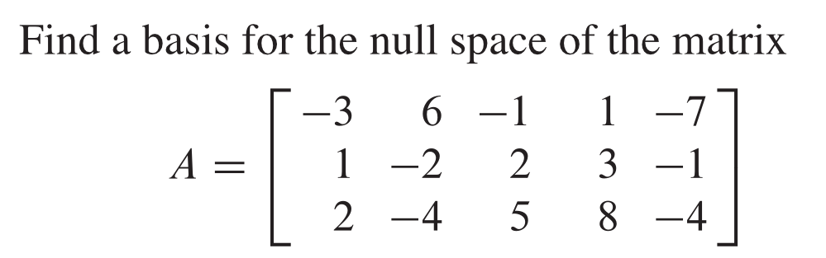
Example

Slide 13
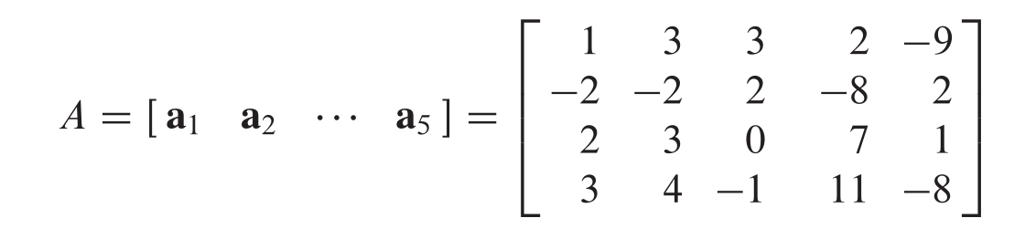
Example: Find a basis for the column space of

Slide 15
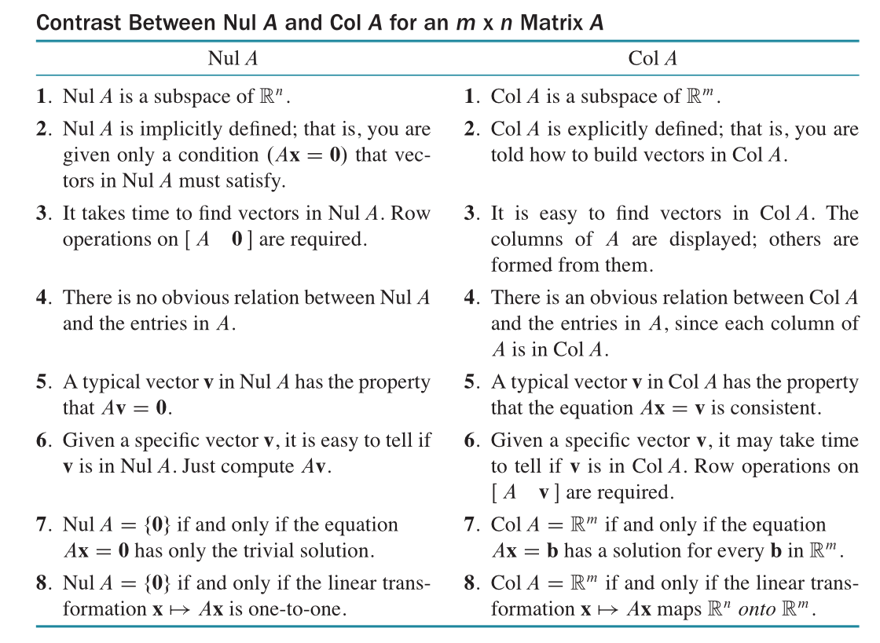

Slide 16
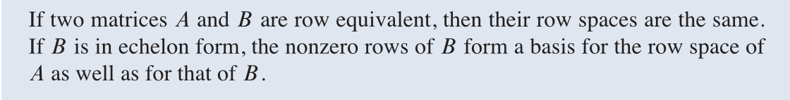
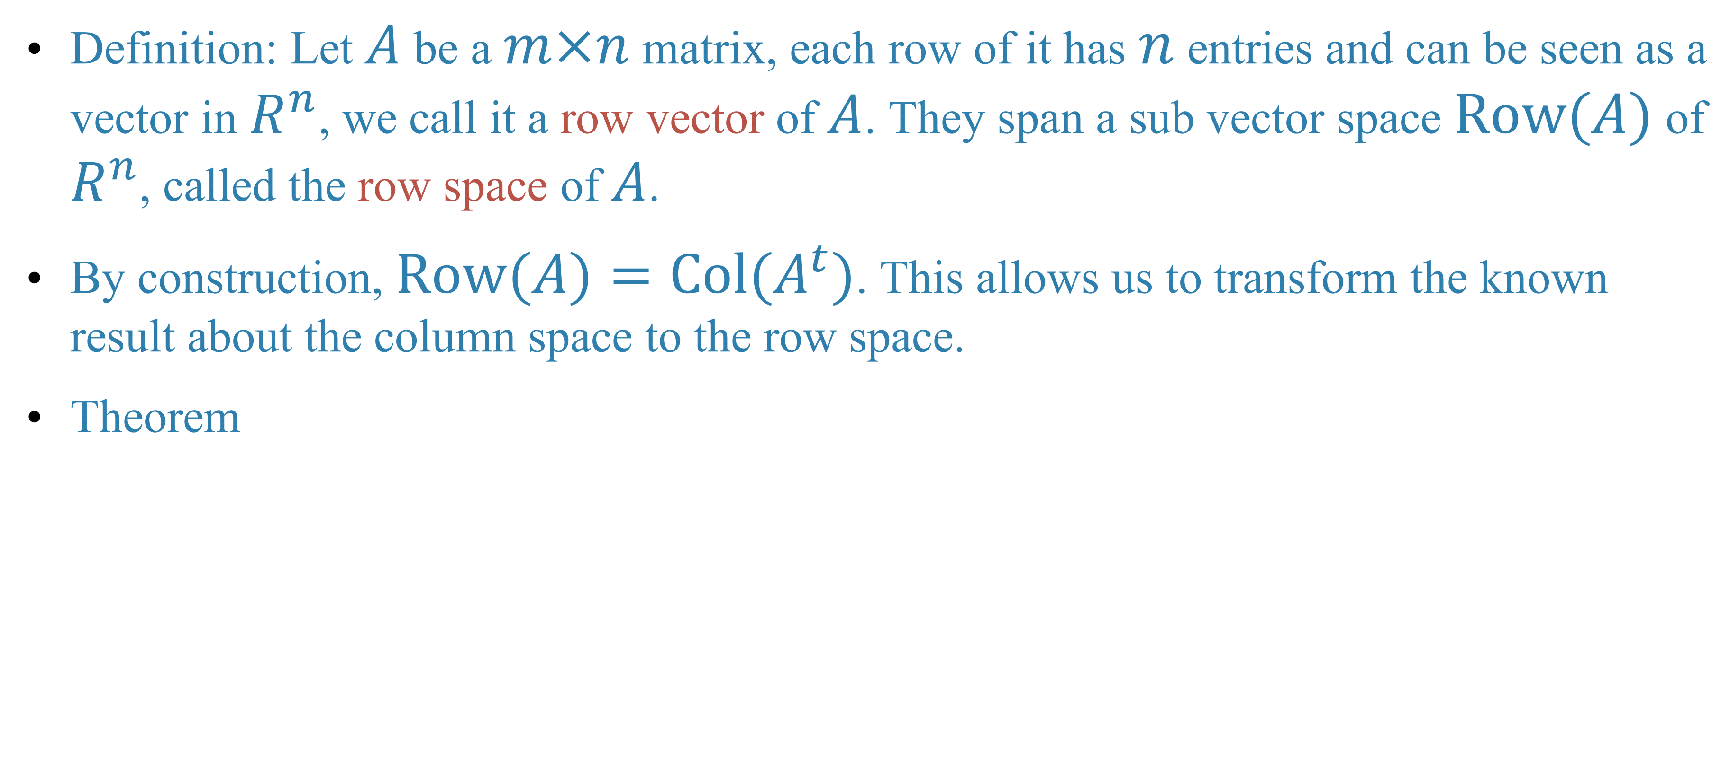
The row space of a matrix
Definition: Let $A$ be a $m×n$ matrix, each row of it has $n$ entries and can be seen as a vector in $R^{n}$, we call it a row vector of $A$. They span a sub vector space $Row(A)$ of $R^{n}$, called the row space of $A$.
By construction, $Row(A)=Col(A^{t})$. This allows us to transform the known result about the column space to the row space.
Theorem

Slide 19
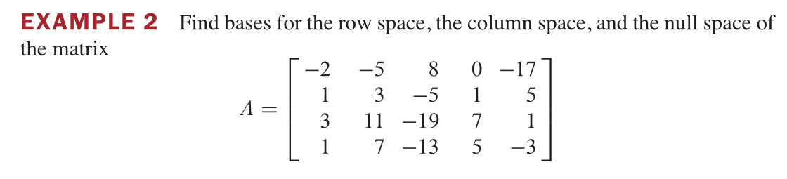

Slide 22
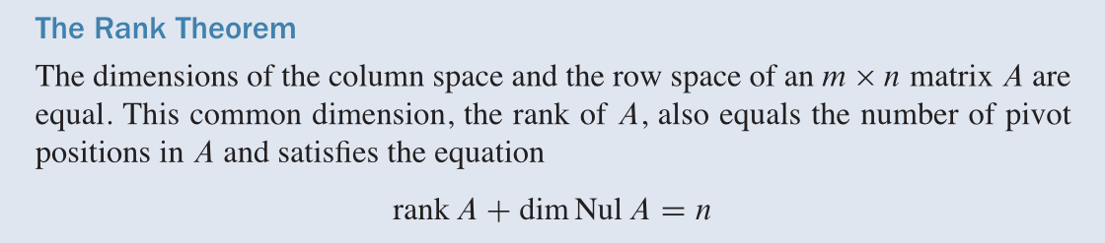
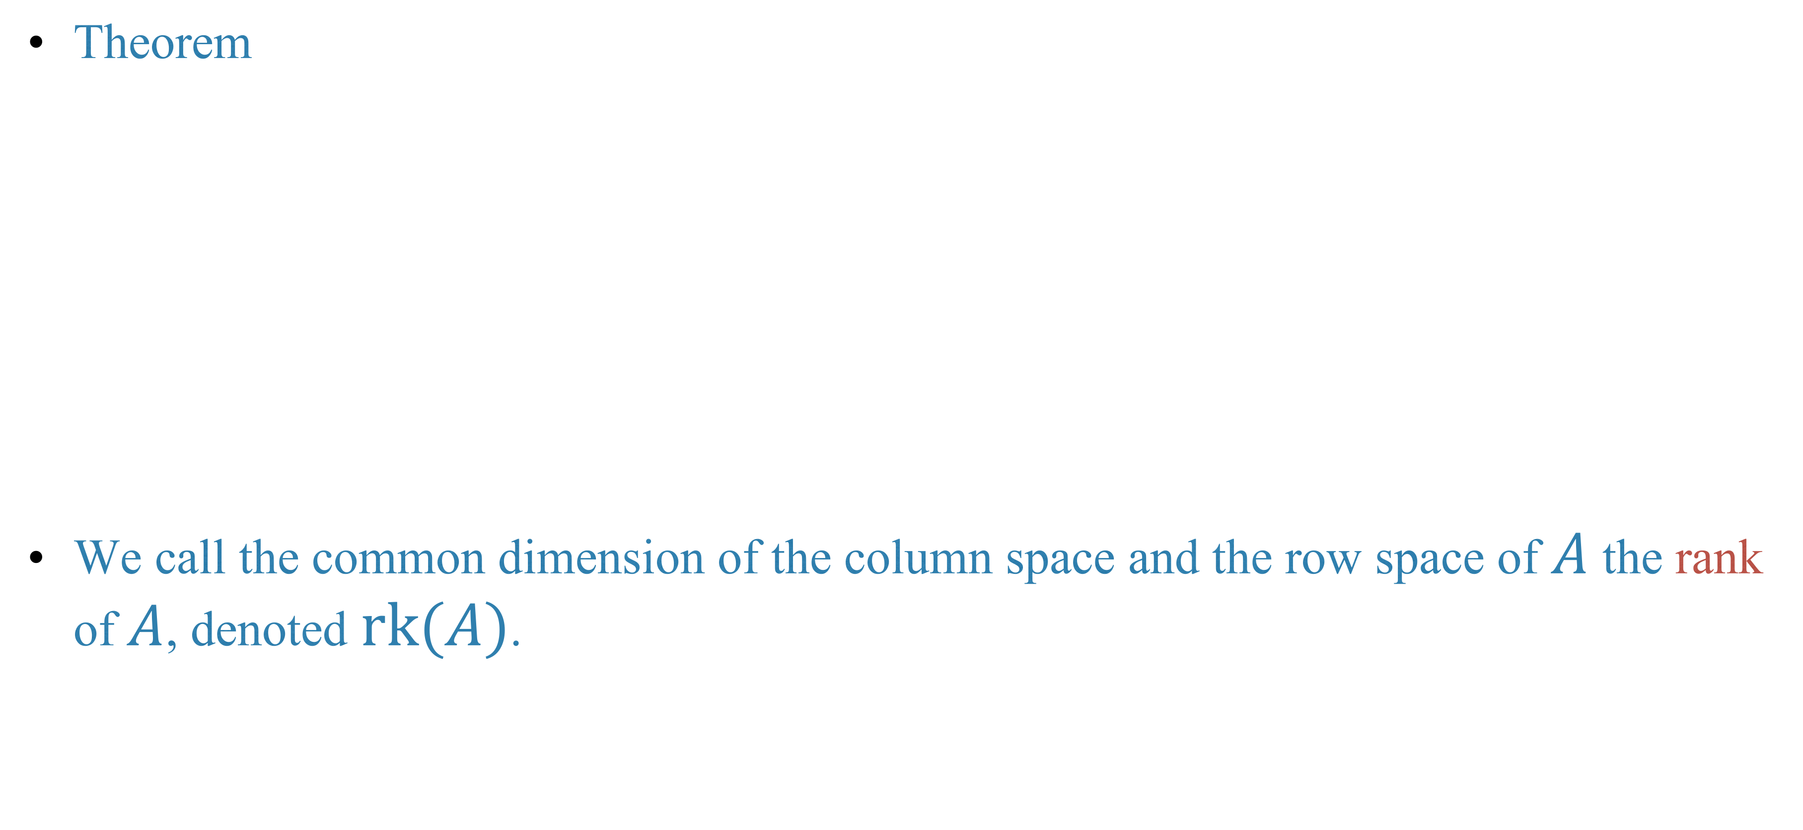
The rank of a matrix
Theorem
We call the common dimension of the column space and the row space of $A$ the rank of $A$, denoted $rk(A)$.

Slide 24
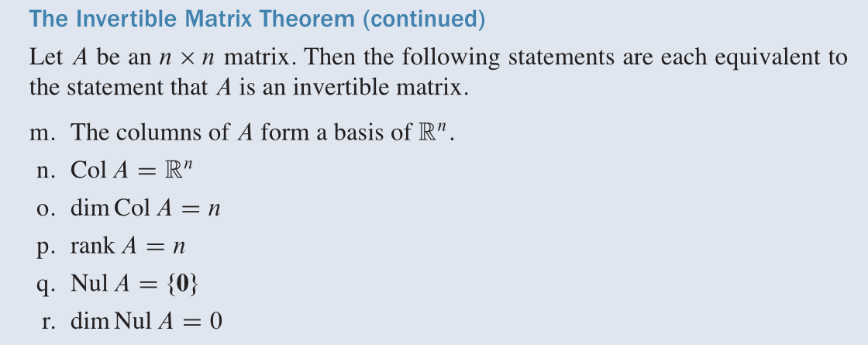

Slide 25
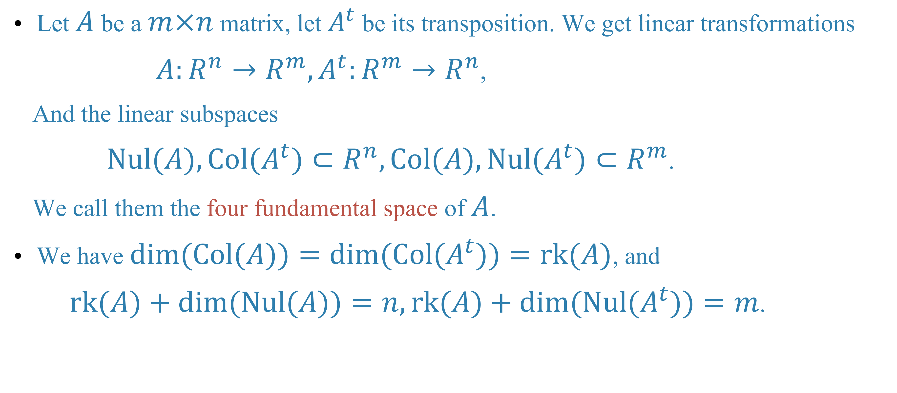
The four subspace of a matrix
Let $A$ be a $m×n$ matrix, let $A^{t}$ be its transposition. We get linear transformations
$A:R^{n}→R^{m},A^{t}:R^{m}→R^{n}$,
And the linear subspaces
$Nul(A),Col(A^{t})⊂R^{n},Col(A),Nul(A^{t})⊂R^{m}$.
We call them the four fundamental space of $A$.
We have $dim(Col(A))=dim(Col(A^{t}))=rk(A)$, and
$rk(A)+dim(Nul(A))=n,rk(A)+dim(Nul(A^{t}))=m$.

Slide 26
Homework
Lay-Lay-McDonald, chapter 2, 2.8 exercises, question 37
Lay-Lay-McDonald, chapter 4, 4.2 exercises, question 37, 39
Lay-Lay-McDonald, chapter 4, 4.5 exercises, question 33

Slide 27
Next time
Lay-Lay-McDonald, chapter 4, 4.7

